Slide 1

Online Course Recommendation System
Mentor: ADHVAITH
Team Members:
• ESLAVATH UPENDAR
• NITHIN VUDIKALA
MEGHANA
SRIKANTH C H
SWATHI S
RISHITHA

Slide 2
Objective:
• To analyze the online course dataset and understand key patterns through Exploratory Data Analysis (EDA).
• To develop a recommendation system that suggests relevant courses to learners.
• To analyze user engagement, ratings, and course attributes.
• To support personalized learning by providing accurate course recommendations.

Slide 3
Dataset Details:
• The dataset contains user interaction and course-related information used for course recommendation.
• Total Records: 100,000
• Total Features: 14
• Feature Types: Mix of numerical and categorical attributes.
• Dataset supports recommendation system modeling.

Slide 4
Features of the Dataset:
• User Information: user_id, previous_courses_taken
• Course Information: course_id, course_name, instructor
• Course Attributes: course_duration_hours, difficulty_level, certification_offered
• Engagement Metrics: time_spent_hours, enrollment_numbers
• Feedback Metrics: rating, feedback_score
• Additional Details: course_price, study_material_available

Slide 5
Problem Statement
• The objective is to recommend suitable online courses to learners based on their interests and engagement.
• Helps users choose relevant courses efficiently.
• Improves personalized learning experience.
• This is a recommendation system problem.

Slide 6
Missing Values Analysis
• The dataset was checked for missing values across all features.
• No missing values were found in any column.
• All records are complete and consistent.
• No imputation or data removal was required.

Slide 7
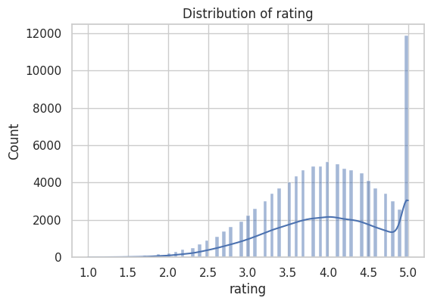
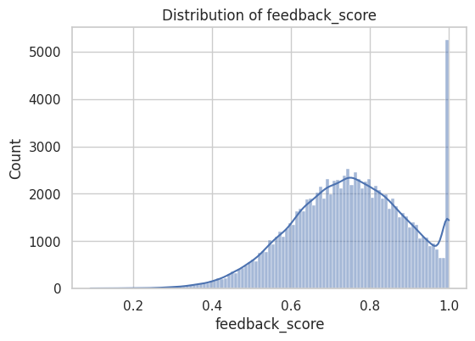
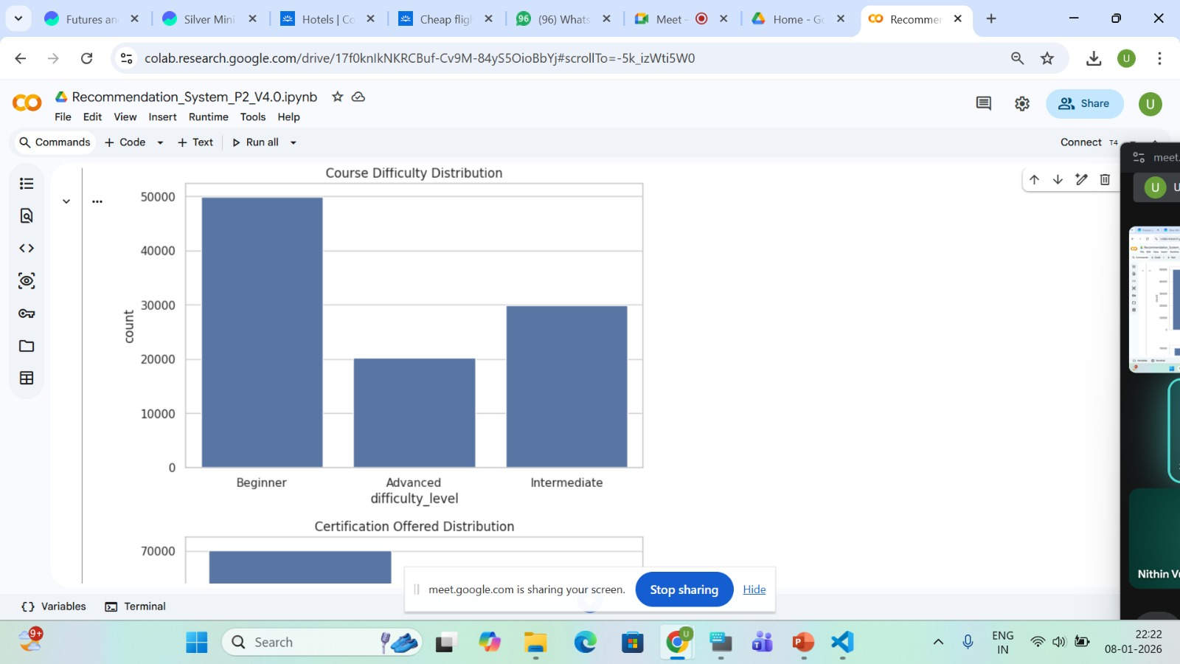
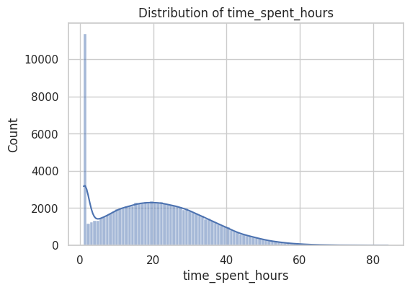
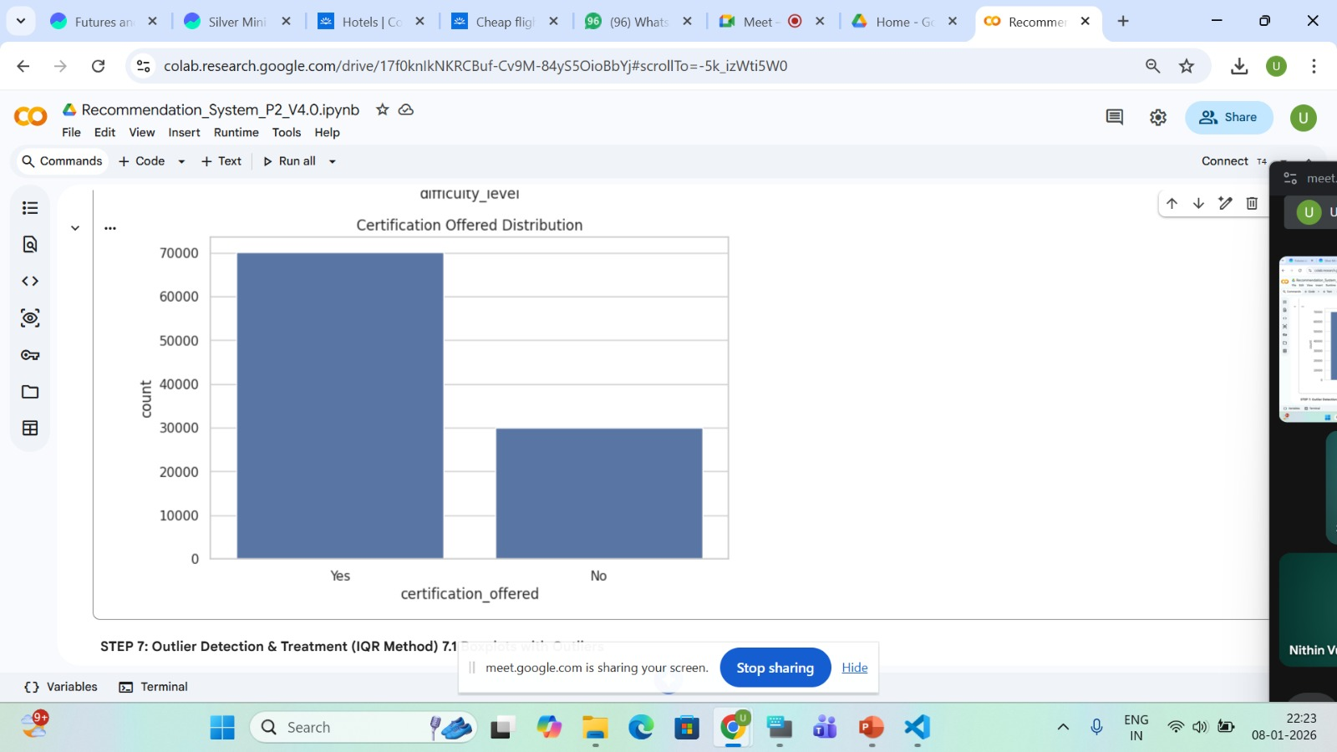
Features Distribution:
• Shows the distribution of numerical features and categorical in the dataset. • Most features show varied distributions with different ranges and spreads. • Some features are skewed, indicating differences in learner behavior and course characteristics. • Distribution analysis helps understand data spread before model building.

Slide 8
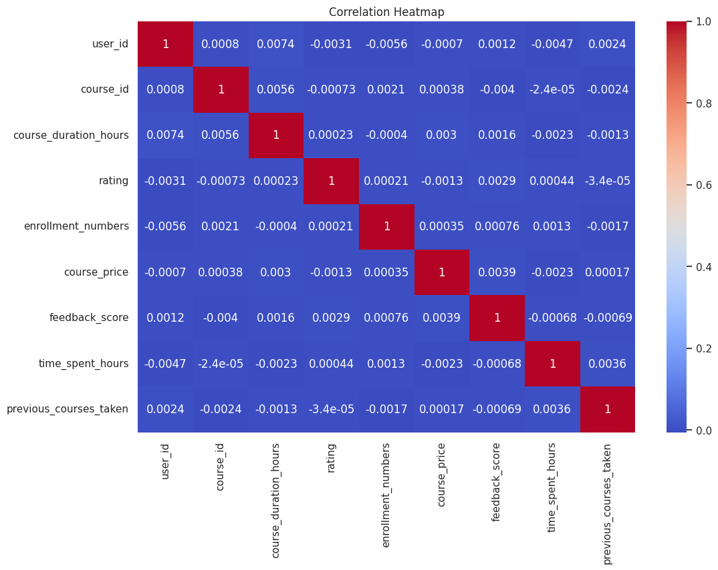
Correlation Matrix:
• Shows the correlation between numerical features in the dataset. • Most features have weak to moderate correlation with each other. • Engagement-related features such as rating, feedback score, and time spent show positive relationships. • Low strong correlation indicates minimal feature redundancy. • Correlation analysis helps understand feature relationships before model building.

Slide 9
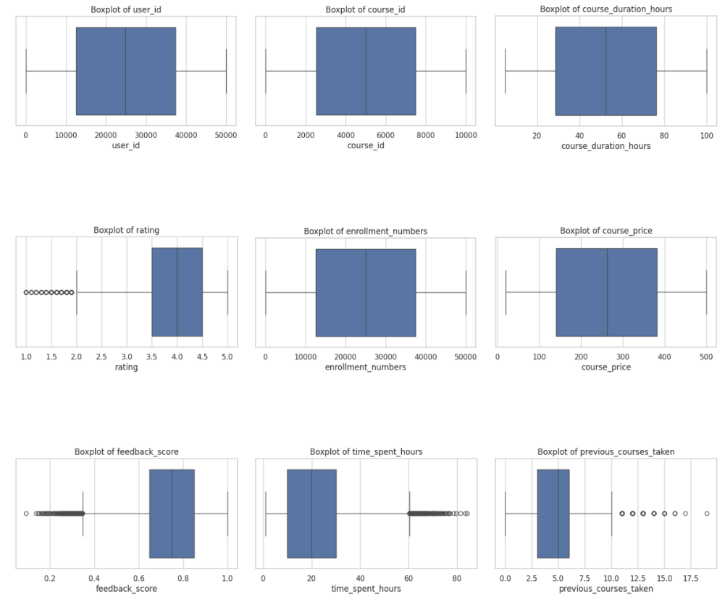
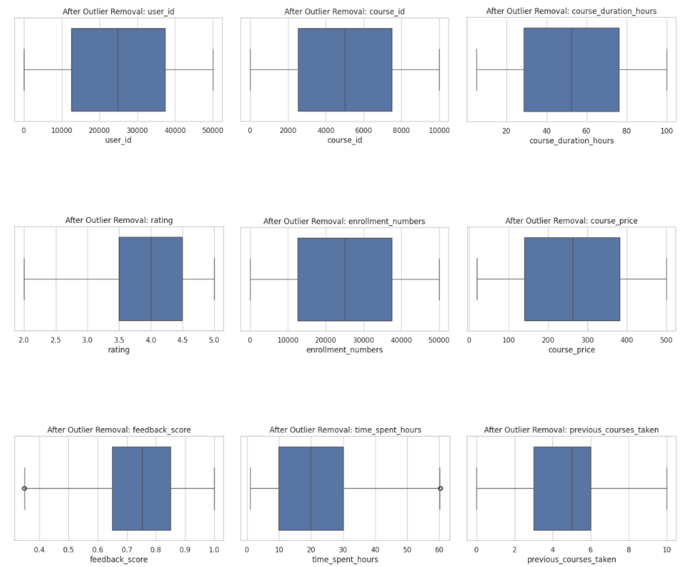
Outlier Detection:
Before outlier :
After Outlier :
• Several numerical features show the presence of extreme values. • Features such as rating, feedback_score, time_spent_hours, previous_courses_taken contain visible outliers. • Outliers increase data spread and skew distributions. • Presence of extreme values may affect model learning and performance. • Outlier detection helps identify irregular patterns in the data.
• Outliers were treated to reduce the effect of extreme values. • Data distributions became more compact and stable. • Reduced skewness observed in features like rating and feedback_score. • Central tendencies are more clearly represented after treatment. • Outlier removal helps improve model robustness and consistency.
.

Slide 10
Data Preprocessing:
• The dataset was reviewed for data quality and consistency.
• No missing values were found across any of the features.
• Categorical variables were converted into numerical format for model compatibility.
• Numerical features were scaled to maintain a uniform range.
• Outliers were identified and treated to reduce the impact of extreme values.
• The final processed dataset was prepared for model building.

Slide 11
Model Building:
• Different recommendation approaches were explored during model development.
• Collaborative Filtering was studied to understand recommendations based on similar user behavior.
• Content-Based Filtering was analyzed using course attributes and user preferences.
• A Hybrid Recommendation approach was reviewed by combining multiple recommendation methods.
• A Popularity-Based Recommendation Model was built using ratings, enrollment numbers, and feedback scores to rank courses.

Slide 12
Model Evaluation:
• Model evaluation was performed based on the quality of course recommendations.
• Recommended courses were compared against user ratings and engagement patterns.
• Courses with higher ratings and feedback scores were ranked higher in recommendations.
• Users with more historical interactions received more accurate and relevant recommendations
. • Performance was limited for new users due to the cold-start problem.

Slide 13
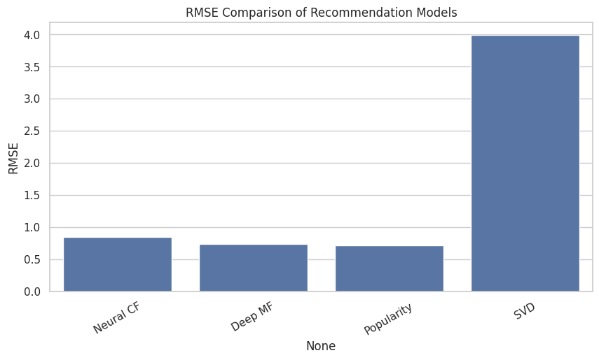
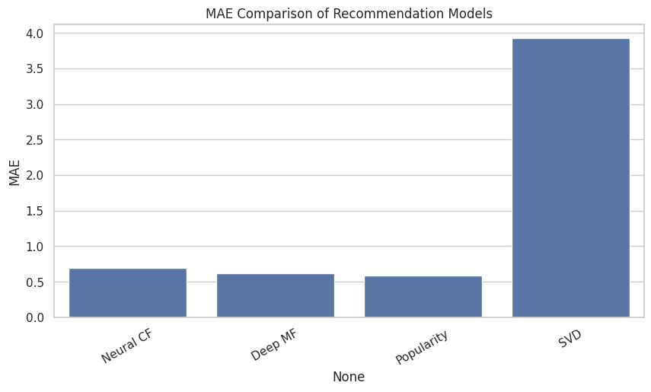
Final Model Selection:
• Multiple recommendation models were evaluated using error-based metrics. • Model performance was compared using RMSE (Root Mean Squared Error) and MAE (Mean Absolute Error). • The Popularity-Based Recommendation Model achieved the lowest RMSE of 0.7122. • The Popularity model also achieved the lowest MAE of 0.5896. • Lower RMSE and MAE indicate better prediction accuracy and stability. • Compared to Neural CF, Deep MF, and SVD, the Popularity model performed the best. • Hence, the Popularity-Based model was selected as the final model.

Slide 14
Challenges Faced:
• Lack of personalized recommendations due to the popularity-based approach.
• Same popular courses are recommended to all users.
• New or less-enrolled courses receive low visibility.
• Recommendations depend heavily on ratings and enrollment numbers.
• Difficulty in maintaining diversity among recommended courses.
• Model does not consider individual user preferences or learning history.

Slide 15
Key Findings:
• Course popularity is strongly influenced by ratings and enrollment numbers.
• Highly rated courses tend to have higher learner engagement.
• Popular courses are consistently preferred by a large number of users.
• Popularity-based ranking provides stable and reliable recommendations.
• Feedback score helps identify well-received courses.
• The approach works effectively even without individual user history.

Slide 16
Future Scope:
• Enhance the system by incorporating personalized recommendations.
• Integrate collaborative filtering to consider user behavior and preferences.
• Combine popularity-based approach with content-based features.
• Improve recommendations for new and less popular courses.
• Update popularity metrics dynamically using real-time user feedback.
• Deploy the system at scale for larger online learning platforms.

Slide 17
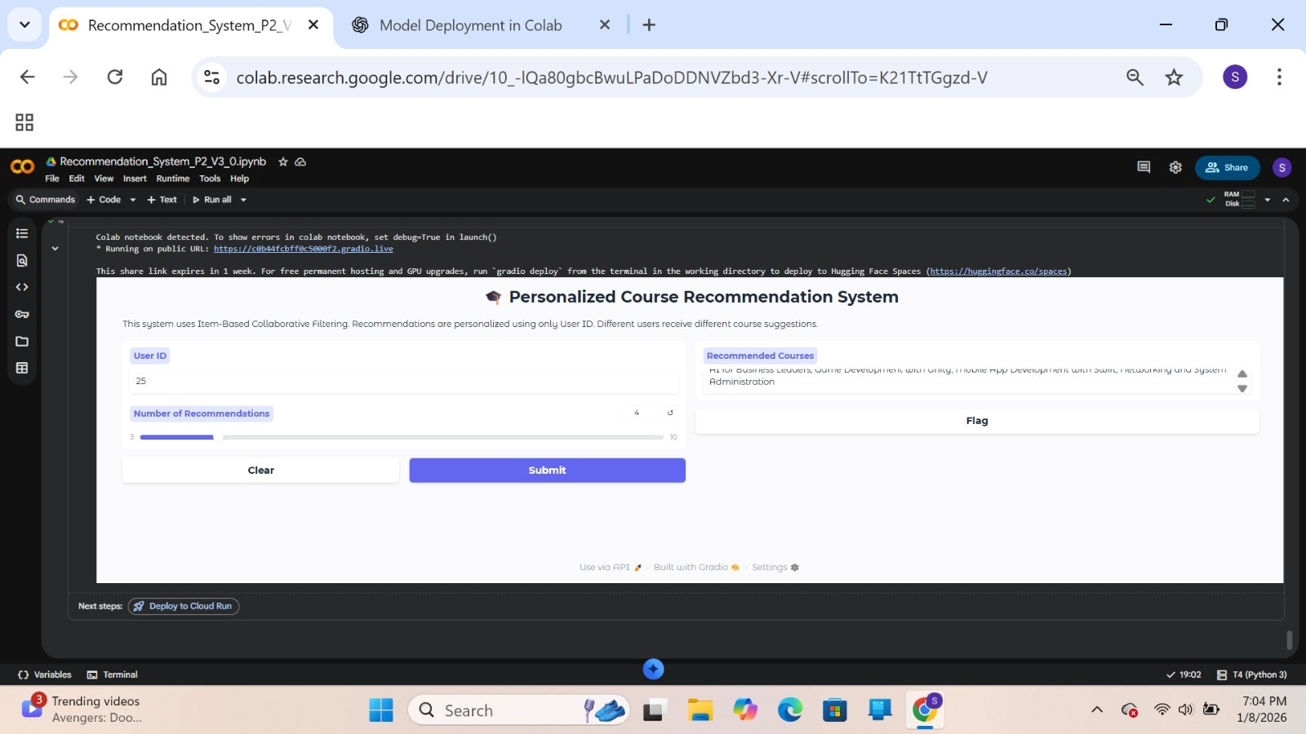
Deployed Application Interface
• A user-friendly web interface was developed for course recommendation. • The application allows users to enter a User ID as input. • Users can select the number of recommendations required. • The system generates personalized course recommendations based on user interaction data. • Different users receive different course suggestions. • The interface displays the recommended course list clearly for the user.

Slide 18
Conclusion:
• Successfully developed an online course recommendation system.
• Implemented a popularity-based recommendation approach.
• Courses are recommended using ratings, enrollment numbers, and feedback scores.
• The model provides stable and reliable course suggestions.
• The system is suitable for platforms with limited user-specific data.
• The project demonstrates how data-driven insights can support course discovery.

Slide 19
Thank you

